Slide 1
Szőlőcukor25ezer kft
Made by: Szilárd Rigó, Kornél Kocsis, Martin Váncsa

Slide 2
Welcome to our project presentation.
Today, we are excited to introduce our website, which sells gambling accessories online.
We created this project as part of our Software Developer Technician exam.

Slide 3
Introduction
Our goal was to design a fully functional e-commerce platform focused on gambling accessories, such as cards, dice, poker chips, and more.
The platform aims to be user-friendly, secure, and scalable for future growth.

Slide 4
Technologies Used
We used the following technologies:
PHP for backend logic and server-side operations.
HTML and CSS for structuring and designing the pages.
JavaScript to enhance user interactions and dynamic content.
phpMyAdmin with MySQL to manage the database.

Slide 5
Main Features
The main features of our website include:
User registration and login system
Product catalog and detailed product pages
Shopping cart functionality
Basic order management for users

Slide 6
System Architecture
Our system follows a classic structure:
Frontend for user interaction
Backend with PHP handling requests and database communication
MySQL database storing user data, products, and orders

Slide 7
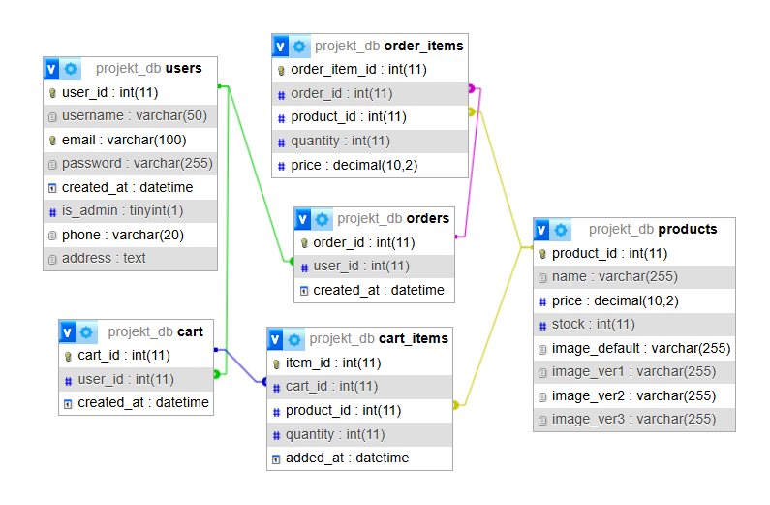
Database Design
We used phpMyAdmin to create and manage our database. The database includes the following main tables:
Users
Products
Orders
Order_Items
Cart_items
Cart
.

Slide 8
Development Process
Our development process consisted of several stages:
Requirements analysis and planning
Database design and setup
Frontend page development
Backend development with PHP
Integration and testing
We worked iteratively, testing and improving after each major step.

Slide 9
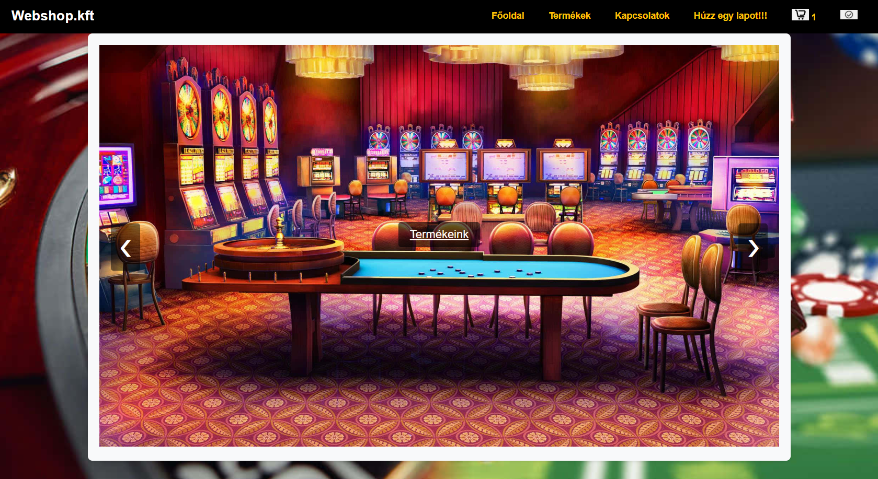
Main page:

Slide 10
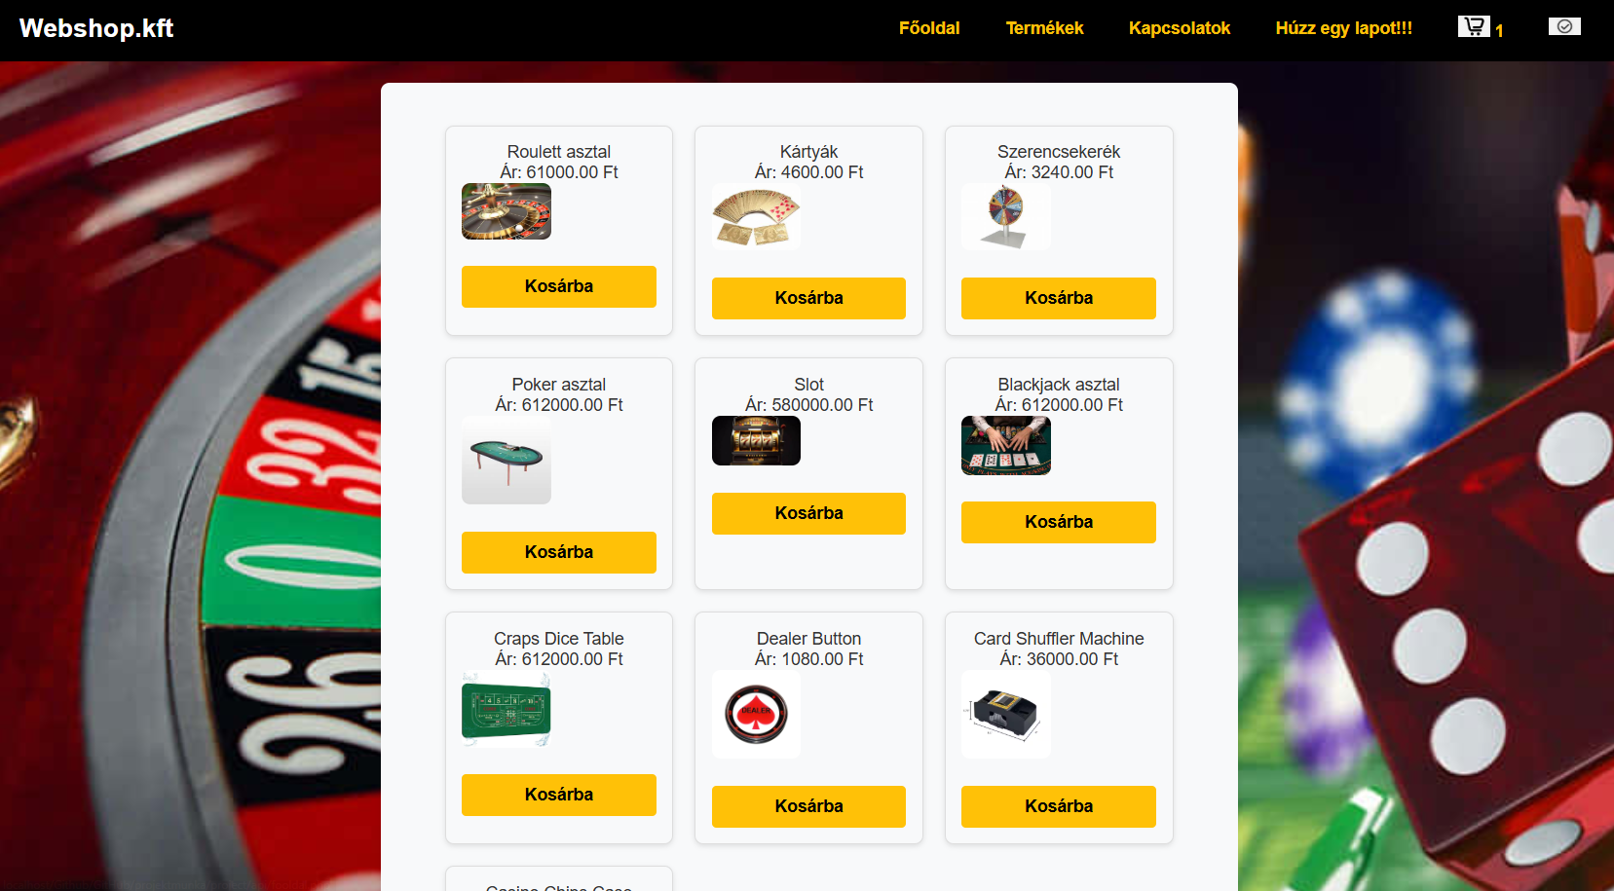
Product page:

Slide 11
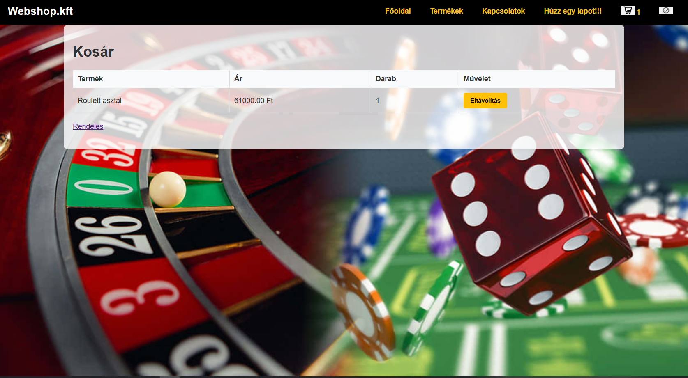
Shopping cart page:

Slide 12
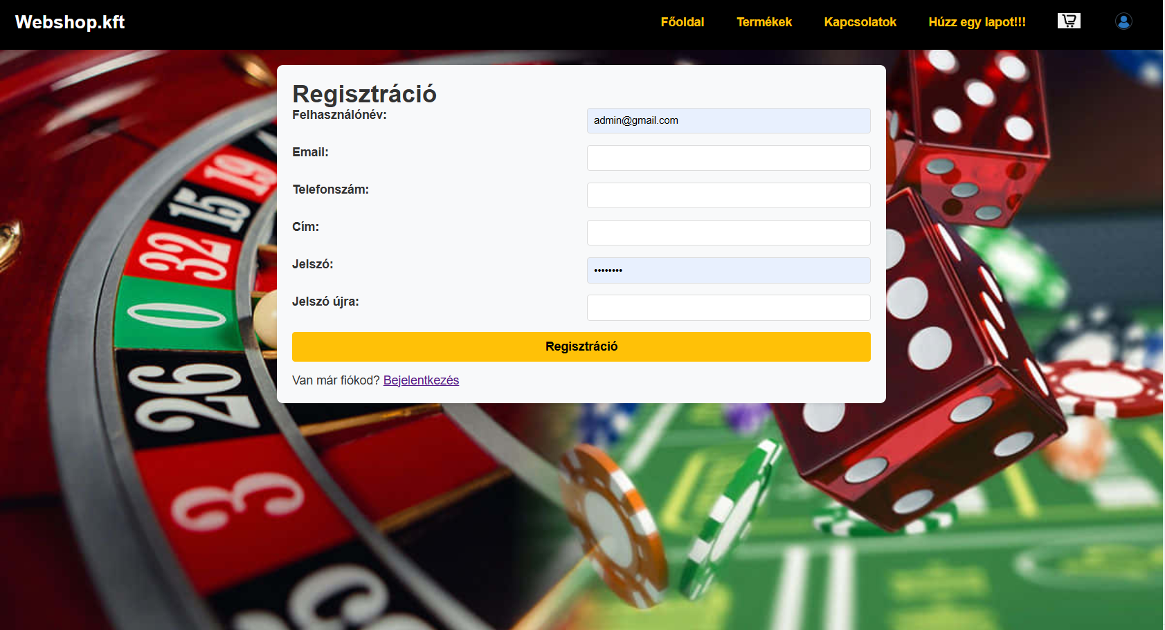
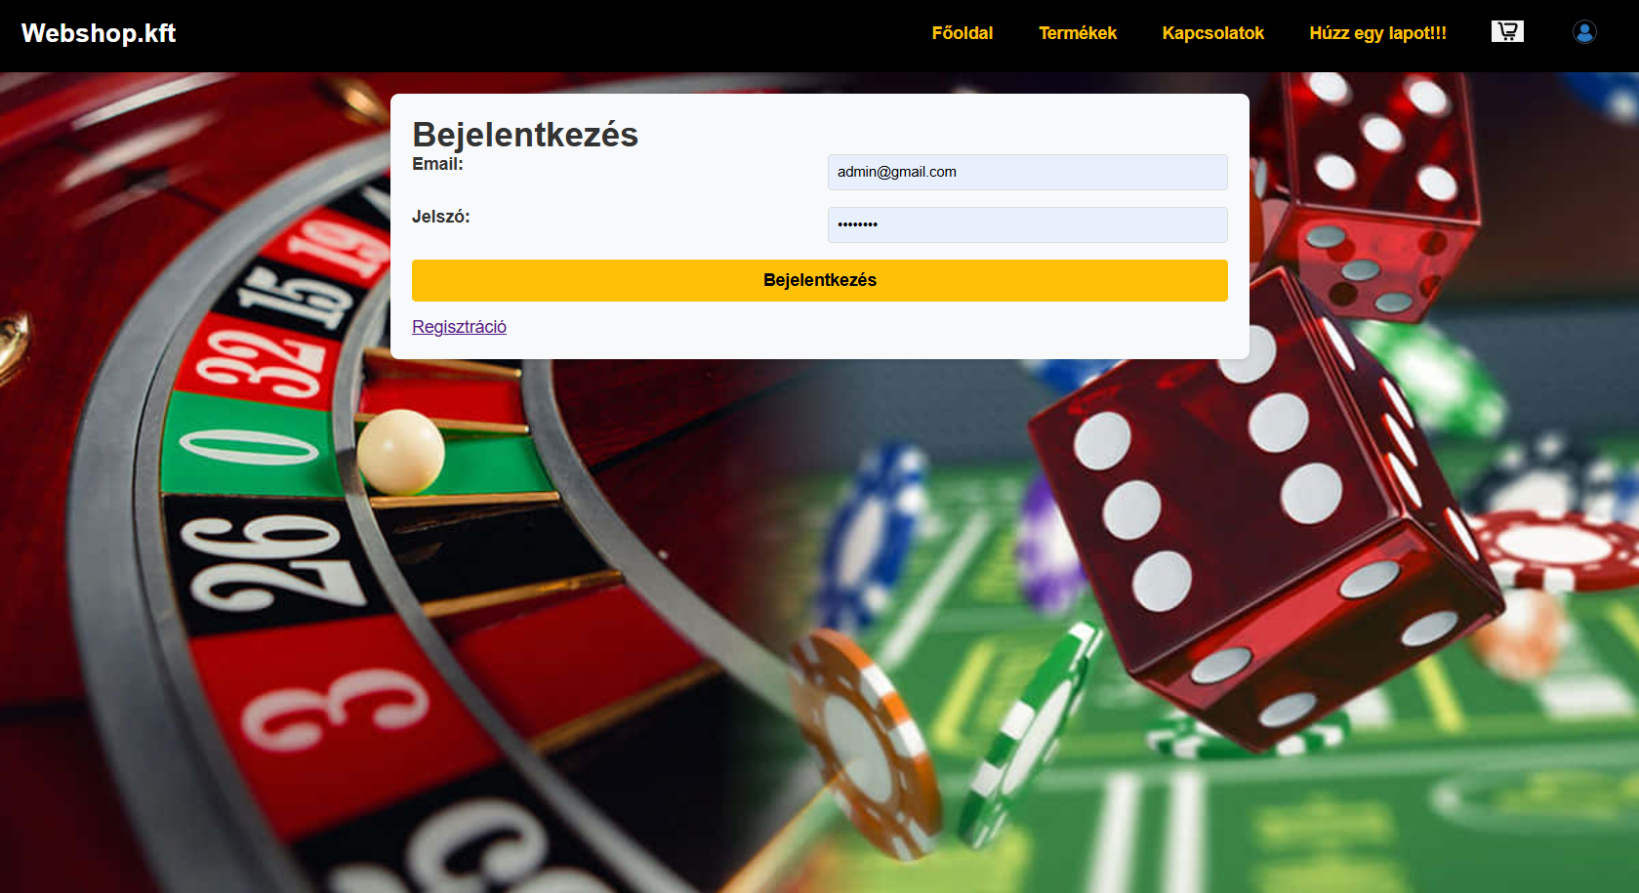
Login/Register page:

Slide 13
Challenges and Solutions
Some challenges we faced included:
Handling user authentication securely
Managing product stock dynamically
Ensuring the cart persisted properly through sessions
We overcame these challenges with session management, careful database queries, and user input validation."

Slide 14
Possible Future Improvements
If we had more time, we would like to:
Add payment integration (e.g., PayPal)
Improve the UI with modern frameworks like React or Vue.js
Implement more advanced user roles and permissions
Optimize the database queries for larger datasets

Slide 15
Summary
We successfully created an online gambling accessory store.
We used PHP, HTML, CSS, JavaScript, and MySQL.
We gained valuable experience in full-stack development and database management.

Slide 16
Thank you!
Thank you very much for your attention.
We are happy to answer any questions you might have!

